Slide 1
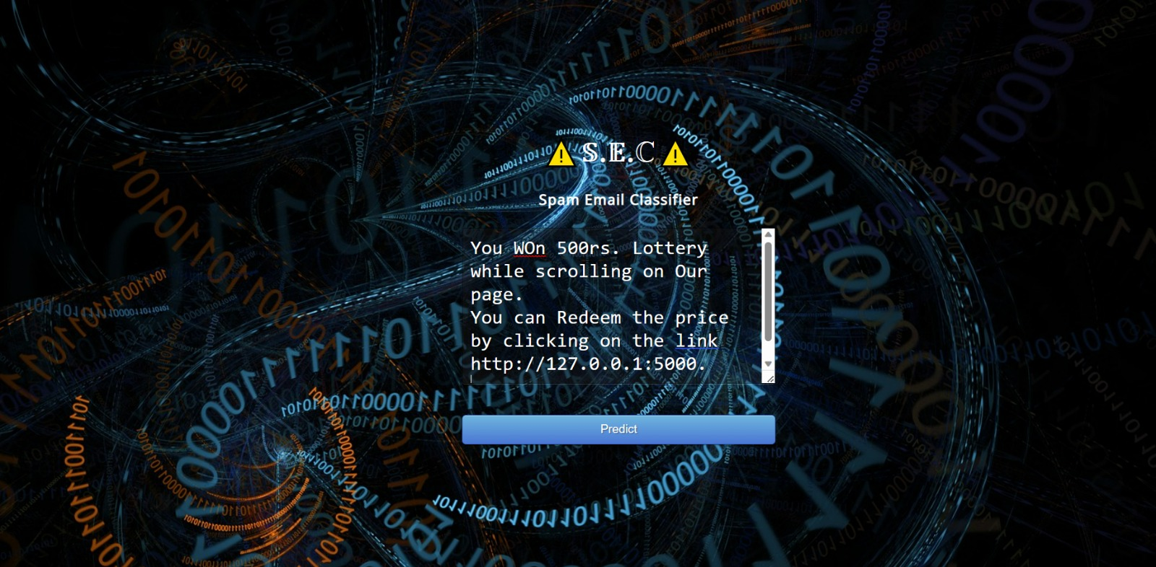
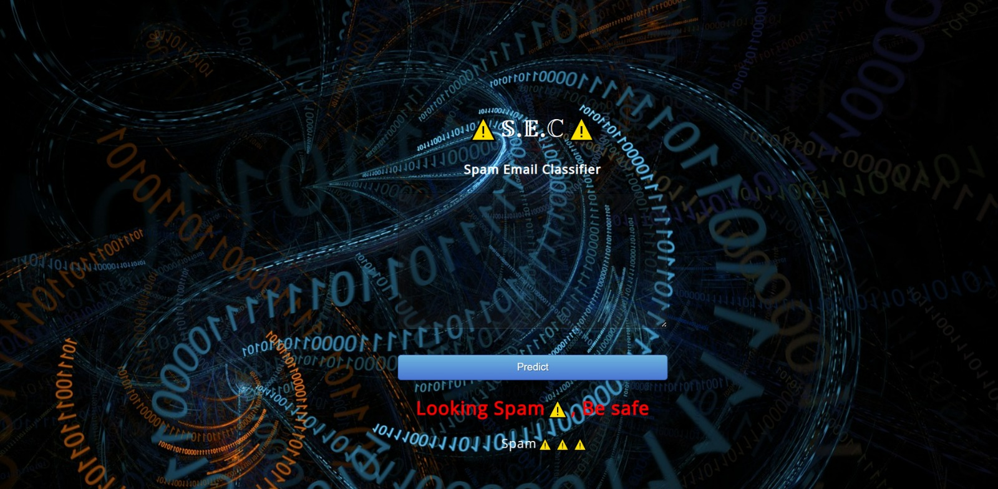
S.E.C
Spam Email/SMS Classifier
Atharva Pagare , Atharva Puranik, Bhumika Patidar
Introduction
Result
Conclusion
Introduction The internet has progressively assimilated into daily life. The number of people using email is growing daily as a result of increased internet usage. Spam, or unsolicited mass email, is an issue that has arisen as a result of the growing usage of email. Due to email's current status as one of the greatest mediums for advertising, spam emails are produced.
Emails that the recipient does not want to receive are referred to as spam. When we disclose our email address on an unofficial or dishonest website, spam frequently results .Spam has several negative impacts. fills our Inbox with a large amount of absurd emails.significantly reduces our Internet speed.
Spam emails, often referred to as "non-self," are unwanted commercial or harmful emails that damage or hack personal information like bank accounts, information relating to money, or anything else that causes harm to a single person, a business, or a group of people.
Therefore, this system is created so that it can identify undesired and unsolicited emails and stop them, aiding in the decrease of spam messages,
Reference
[1]"Spam Filtering: An Overview" by Andrzej M. J. Skulimowski: This paper provides an overview of various spam filtering techniques and their performance. https://ieeexplore.ieee.org/abstract/document/4457923 [2]"A Survey of Techniques for Email Spam Filtering" by A. Sahami, S. Dumais, D. Heckerman, and E. Horvitz: This paper.
[3]"A Review of Machine Learning Techniques for Spam Email Detection" by N. K. Singh and A. K. Garg: This paper reviews various machine learning techniques that have been used for spam email detection. https://link.springer.com/article/10.1007/s10796-018-9906-1
Objective
Materials & Method
To reduce the number of unwanted and potentially harmful emails that users receive, thereby improving the overall email experience and reducing the risk of phishing attacks and identity theft.
To develop a machine learning-based spam email detection system that can accurately classify incoming emails as spam or not spam, using a combination of text analysis and statistical modeling techniques.
To train the spam email detection system on a large and diverse dataset of labeled emails, in order to ensure its effectiveness and adaptability to different types of spamming and phishing techniques.
PROPOSED METHODOLOGY For the purpose of detecting spam emails, many approaches may be applied. However, machine learning-based categorization is a widely utilised strategy. Here is a fundamental process for creating a machine learning model for spam email detection: 1.) Data Gathering: Gather both valid and spam emails as part of a sizable and varied dataset. 2.) Preprocessing Data: Remove any extraneous information from the data, such as HTML elements, punctuation, and stop words.
TechnologyUsed:Python,,Flask Framework,CSS,Html,Machine Learning
Contact
Atharva Pagare-atharvapagare20242@acropoils.in
Atharva Puranik- atharvapuranik20403@acropoils.in
Bhumika Patidar - bhumikapatidar20272@acropolis.in

